Slide 1
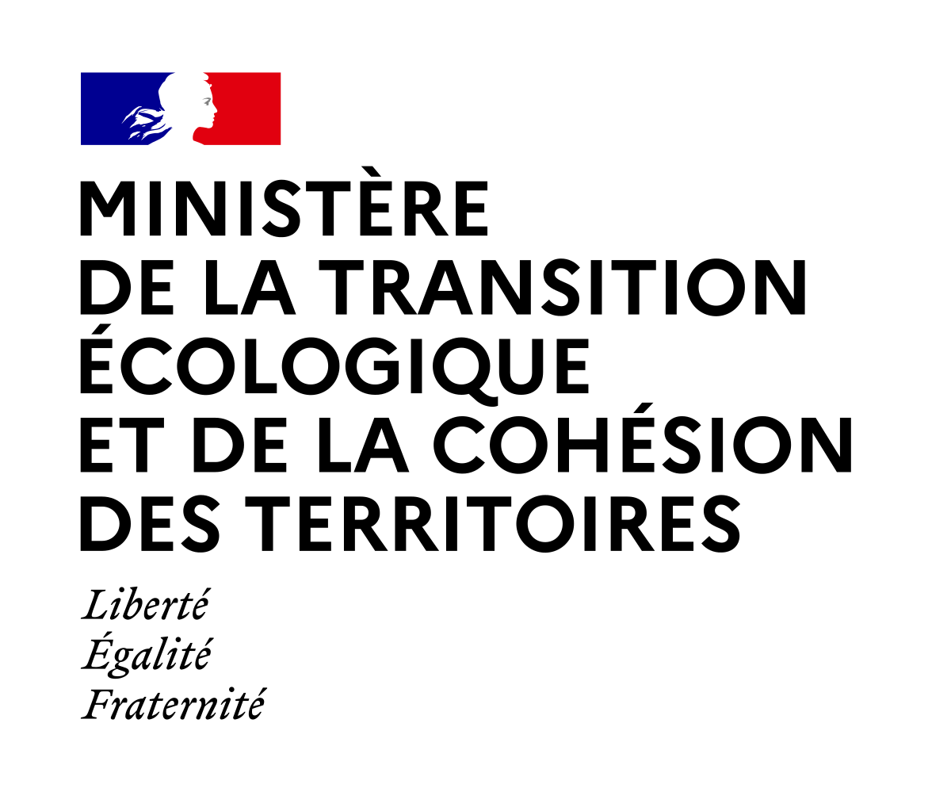
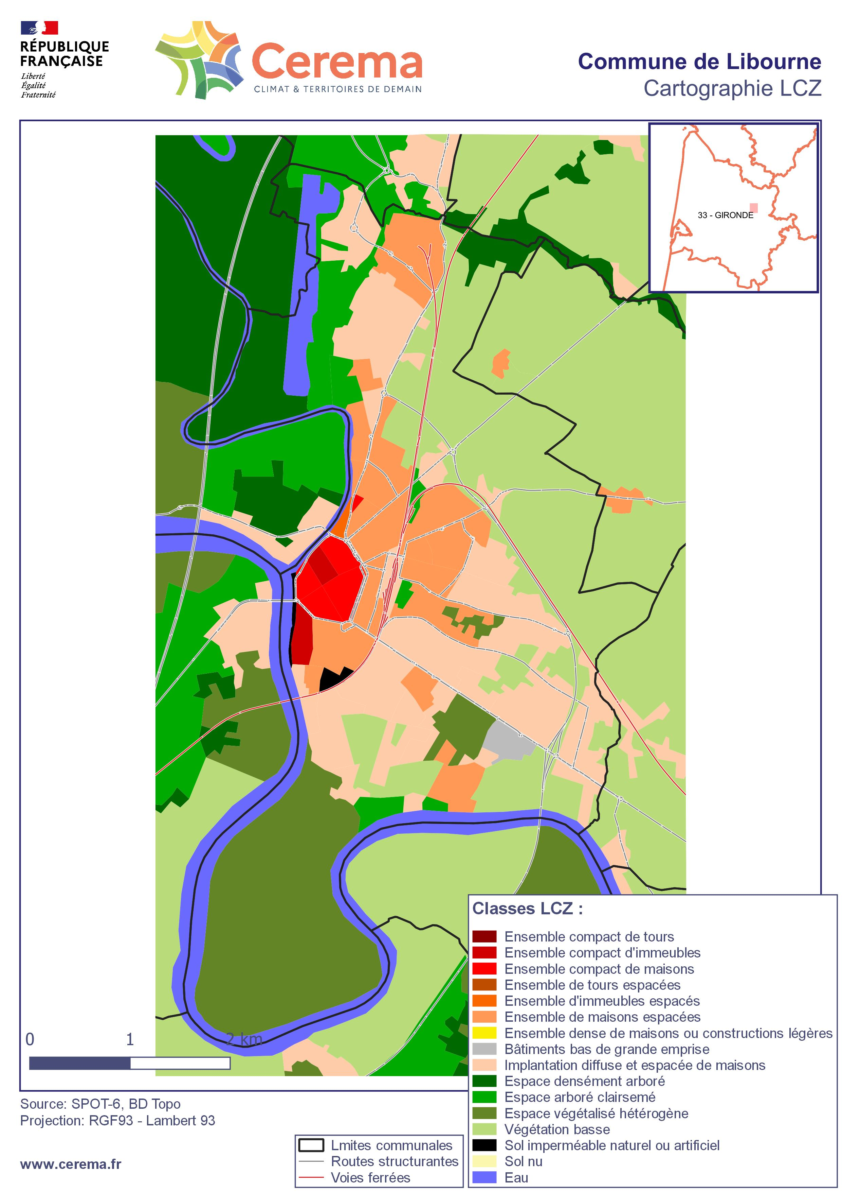
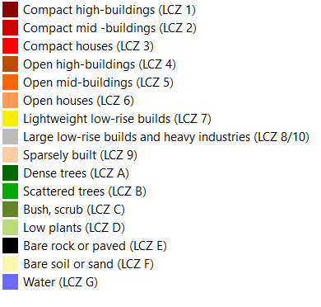
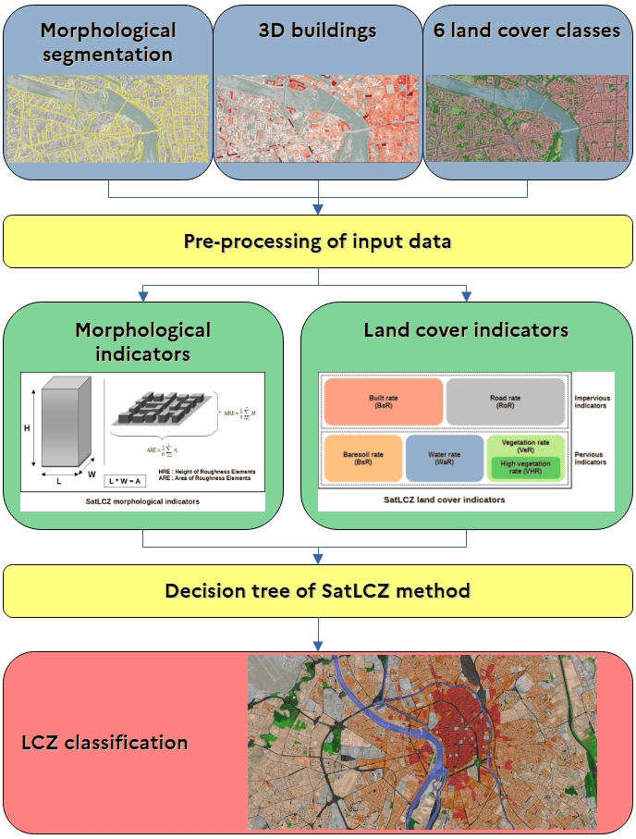
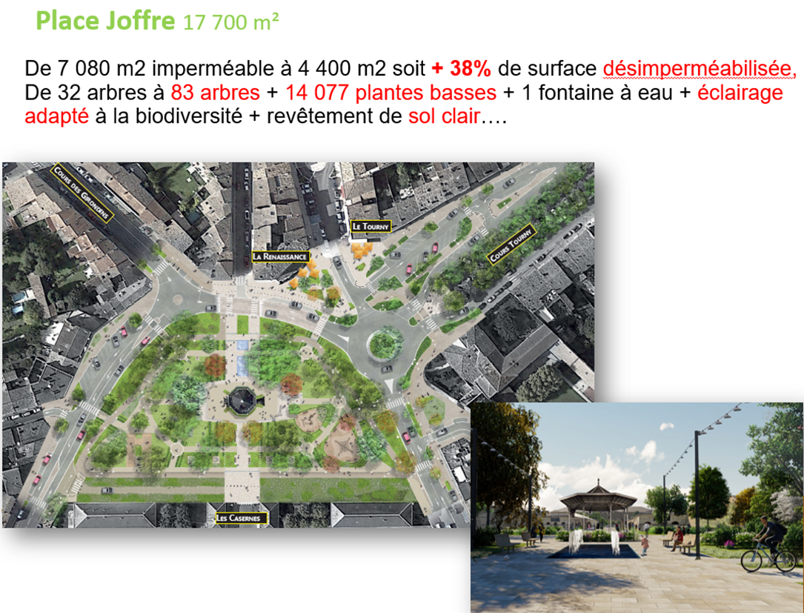
SatLCZ: an operational tool to characterise Urban Heat Island using VHR satellite images
Urban Heat Island (UHI) is one of the main effects of the general urban heat stress phenomenon caused by increasing urbanisation, and an important example of anthropogenic climate change ^{e.g. 1; 2}. The UHI is mainly due to the difference in thermal properties between urbanised and natural land, anthropogenic heat emissions, anthropogenic pollution and limited wind flow between buildings.
The Local Climate Zone (LCZ) concept developed by the international urban climatology community³ permits to render UHI studies more comparable, irrespective of prevailing local urban planning, building materials, city size and geographical location. In other words, the LCZ approach capture the variation in microclimate that typify neighbourhood ^{e.g. 3; 1; 4} in specific cities islands with a radius of ~200 m.
The LCZ approach map the vulnerability of the urban environment during summer heat waves and help local actors to adapt and attenuate heat peaks through better urban design.
Abstract ID : 164
Benjamin Piccinini¹, Julien Bouyer², Teodolina Lopez^{1,3}, Quentin Gautier¹, Arnaud Ceyte¹
(1) Cerema, Direction Occitanie, Satellite Team, Toulouse, France. (2) Cerema, Research team TEAM, Nancy, France. (3) Research team ENDSUM, Le Grand Quevilly, France.
The SatLCZ method developed by Cerema (SatLCZ project co-funded by the SCO-CNES) provides a detailed description of the urban fabric of any city in the world. This method uses as input data very high resolution (VHR) satellite images from the Pléiades (50 cm) or SPOT 6/7 (1.50 m) missions.
C. Application in France (city of Libourne)
A. 2024 national production of LCZ on Metropolitan France
Satellite image (SPOT 6/7)
LCZ classification map
Why?
- Free UHI diagnosis for :
more precise UHI diagnosis,
mitigation planning.
- Homogenous comparison between mid and major French urban areas.
Imperviousness rate:
Basic indicators
How?
SatLCZ tool,
SPOT 6/7 national cover of 2022,
83 urban areas (114 cities with ≥ 50,000 inhabitants).
Input datasets
Land cover classes
Built
Road
Vegetation rate:
Bare soil
Water
High vegetation
Low vegetation
LCZ classes
Derived map
Vulnerability index :
Funding and time?
Funding provided by the French Government for a year project.
B. SatLCZ classification description
Mitigation of UHI of the Joffre Square
The SatLCZ classification is a simplified method based on the original Local Climate Zone (LCZ) concept³ using VHR images. Different data sets can be extracted from these images and used as input for the classification.
From the original 10 indicators, the SatLCZ method only uses 8 indicators to describe :
the urban morphology
(2 indicators),
the land cover (6 indicators).
~40 % of desilted soil.
50 newly planted trees
~15,000 newly planted low plants.
D. Application in Thailand (city of Rayong)
As a result, SatLCZ segments cities into homogeneous elementary typo-morphological units based on their climatic behaviour. This classification is applied either to French cities of various sizes, ranging from ~20,000 to ~1,000,000 inhabitants, or abroad through the study of Rayong in Thailand (~64,000 inhabitants).
Pros | Cons
VHR satellite image as input | Availability of VHR images
Possibility to add exogeneous data (OSM, land use) | Price (stereo acquisition from Pléiades)
Large spatial coverage | Need for adequate IT infrastructure
Uses of derived indicators to describe a city in term of imperviousness or vegetation rate | Intrinsic minimal spatial resolution of the LCZ of 200 m
Take aways:
The SatLCZ method:
relies on using VHR satellite imagery and can be used all over the world.
enables local actors to better understand how their territory reacts to the UHI in order to implement solutions in their urban fabric.
provides basic indicators such as imperviousness or vegetation cover.
can be used in combination with socio-economic dataset to highlight vulnerability index.
The LCZ classification provides :
a first approximation of a city's susceptibility to UHI.
a selection of interesting hotspots for in situ measurement or air temperature modeling.
data to help mitigate UHI and thus provide co-benefits.
¹ Bechtel et al. (2019), doi: 10.1016/j.uclim.2019.01.005.² Bassani et al. (2022), doi: 10.1016/j.uclim.2022.101099. ³ Stewart and Oke (2012), doi: 10.1175/BAMS-D-11-00019.1. ⁴ Rosentreter et al.. (2020), doi: 10.1016/j.rse.2019.111472
For further details:
Contact : Benjamin Piccinini
Description of the SatLCZ project
 | Processing chain
SatLCZ QGIS3 modeler
Notes:
Bloc marque RF Cerema bloqué. Ne peut pas être modifié en position ni
en taille
Police d’écriture à utiliser : Arial uniquement !
Toutes les couleurs du thème sont les couleurs Cerema. Ne pas utiliser d’autres couleurs que celles disponibles dans la palette de ce modèle.
Essayer de ne pas mettre plus de 3 couleurs dans un poster.
Photo modifiable : faire clic droit > Changer d’image > A partir d’un fichier
Différents types de bloc texte possibles :
> Fond blanc, texte bleu
> Fond bleu, texte blanc
> Fond blanc, texte bleu, encadré bleu ou Orange
Eviter d’écrire le texte en Orange Cerema car cela sera moins lisible.
Par contre, le titre et/ou le sous-titre peuvent être mis en Orange ou dans une autre couleur Cerema.
Dans ce modèle, la taille du titre est de 72 pt, le sous-titre est en 60 pt et le texte est en 28 pt.
Cela peut être diminué s’il le faut.
Attention : Essayer de ne pas trop charger le poster afin que cela reste le plus lisible possible.
Pour les graphiques ou tableaux, essayer de ne prendre qu’une couleur et ses dégradés.
Mettre les logos des partenaires en bas de la page. Le cadre peut être agrandi ou réduit en largeur suivant le nombre de logos à intégrer

